Slide 1
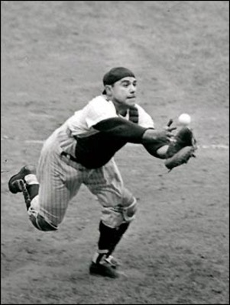
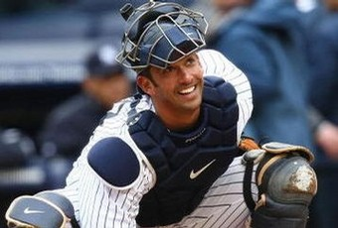
Yogi Berra
By Cade McCarter

Slide 2
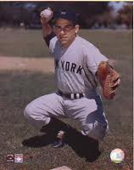
Stats
Yogi Berra had .285 avg.,
385 hr.,
1,430 RBI,

Slide 3
Hall of Fame
Yogi Berra got elected into the Hall of Fame in ‘72. With 339 out of 396 votes the Hall of Fame is a third home for Yogi (his house, and Yankee staduim)!!!

Slide 4
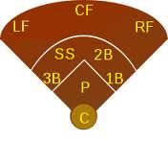
Facts
Yogi is the 3rd best catcher in baseball history!
Including his player, coach, and manager he went to 21 World Series games!!!
Berra played catcher which is located below!!!

Slide 5
Yogi’s Teams
Berra played for the Yankees, coached them and managed them. He traveled from Missouri to New York ‘cause he got drafted from middle school!!!

Slide 6
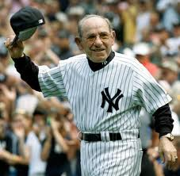
1925-2011
Although Yogi is probably dead, he will always be alive in the league of baseball.

Slide 7
Reference List
A special thanks to:
www.wikipeida.com
www.Espn.com
www.baseballstatics.com
Thank you!!!!! ☺

